Slide 1
Section 6.6 Salt in Seawater
MATH A104
Megan Gobeille

Slide 2
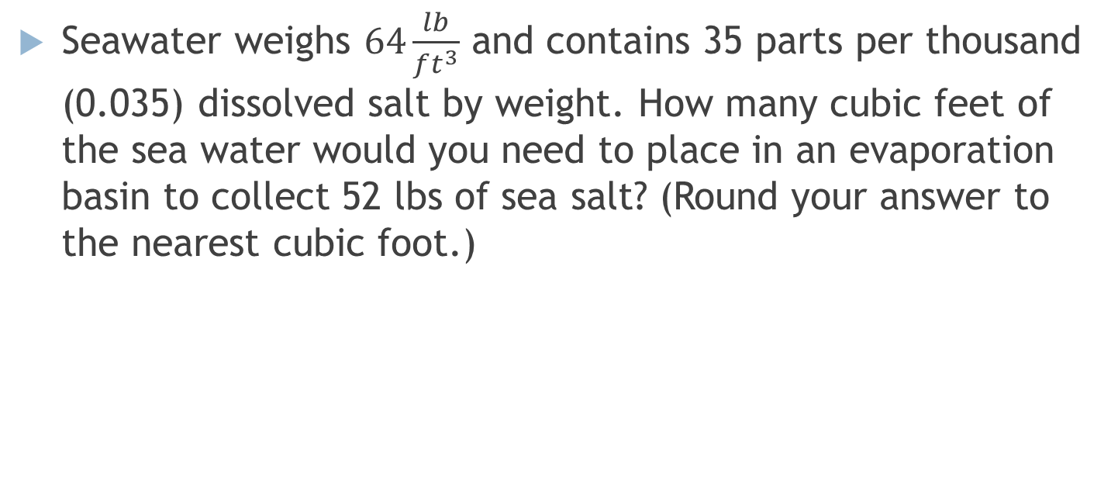
Section 6.6 Salt in Seawater
Seawater weighs $64\frac{lb}{ft^{3}}$ and contains 35 parts per thousand (0.035) dissolved salt by weight. How many cubic feet of the sea water would you need to place in an evaporation basin to collect 52 lbs of sea salt? (Round your answer to the nearest cubic foot.)

Slide 3
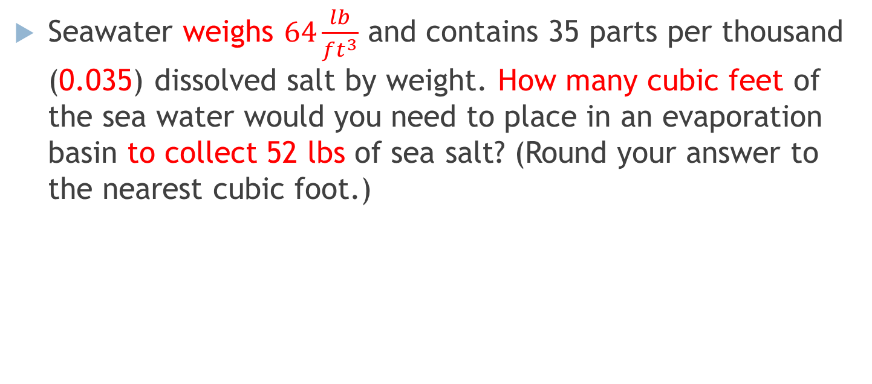
Section 6.6 Salt in Seawater
Seawater weighs $64\frac{lb}{ft^{3}}$ and contains 35 parts per thousand (0.035) dissolved salt by weight. How many cubic feet of the sea water would you need to place in an evaporation basin to collect 52 lbs of sea salt? (Round your answer to the nearest cubic foot.)

Slide 4
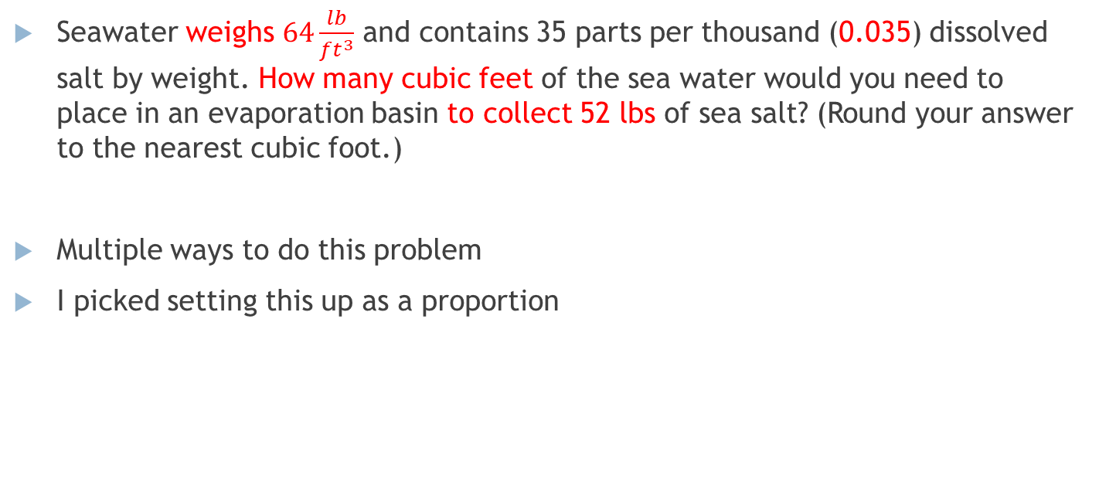
Section 6.6 Salt in Seawater
Seawater weighs $64\frac{lb}{ft^{3}}$ and contains 35 parts per thousand (0.035) dissolved salt by weight. How many cubic feet of the sea water would you need to place in an evaporation basin to collect 52 lbs of sea salt? (Round your answer to the nearest cubic foot.)
Multiple ways to do this problem
I picked setting this up as a proportion

Slide 5
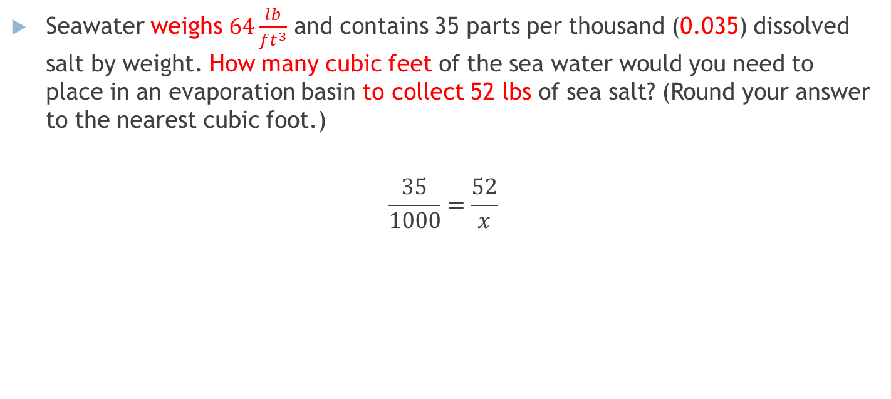
Section 6.6 Salt in Seawater
Seawater weighs $64\frac{lb}{ft^{3}}$ and contains 35 parts per thousand (0.035) dissolved salt by weight. How many cubic feet of the sea water would you need to place in an evaporation basin to collect 52 lbs of sea salt? (Round your answer to the nearest cubic foot.)
$$\frac{35}{1000}=\frac{52}{x}$$

Slide 6

Section 6.6 Salt in Seawater
Seawater weighs $64\frac{lb}{ft^{3}}$ and contains 35 parts per thousand (0.035) dissolved salt by weight. How many cubic feet of the sea water would you need to place in an evaporation basin to collect 52 lbs of sea salt? (Round your answer to the nearest cubic foot.)
So $x=1485.71286 lb$…. But we want cubic feet!

